Slide 1


SmartQuest

Slide 2
College Students Survey
Surveyed 139 students
90%

Slide 3
Our Profits

Slide 4
Annual Profit Plan
💤 Average per night cost of a hotel: $154
💰 Assuming college students stay at a cheaper than average hotel of $112 per night
🏨 50/50 split of weeklong and weekend ✈️ Airline affiliate cut is $3 per booking
📅 100 bookings per month → yearly revenue of $60,480
🗓 500 bookings per month → would result in yearly revenue of $302,400

Slide 5
Customer Relationships

Slide 6
Starting Locally
Future and Growth
Grow into other universities around the country
12.0 million college students under age 25
→Student body of 66,000 students

Slide 7
Why SmartQuest?
Safe: College student identification and email validation system.
Affordable: Sharing accommodation costs for groups of 2+
We offer rewards with every booking, based on:
Amount spent on trip
Destination
Number of people connected and traveling together

Slide 8
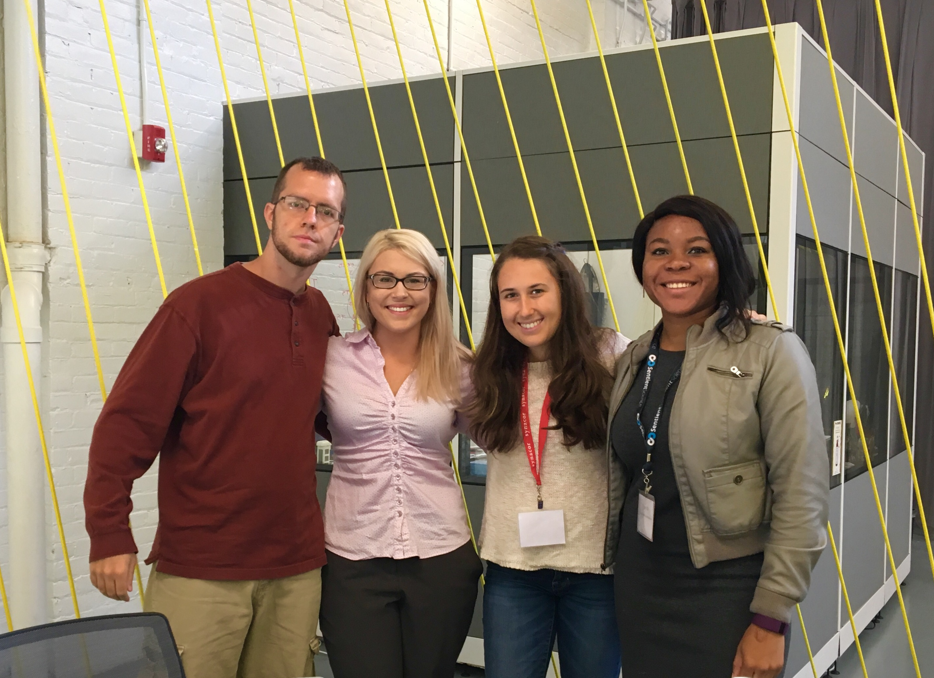
SmartQuest

